Slide 1
Online Decision-Making Algorithms for Data-Driven Operations
Hamsa Bastani
Wharton OID
Joint work with Mohsen Bayati and Khashayar Khosravi

Slide 2


Healthcare
Possible Interventions:
Treatment plan: choice of medication¹
Length of Stay: additional day under observation²
Discharge Location: skilled nursing facility, home care³
Quality of Life: joint replacement for osteoarthritis⁴
$$⋮$$
¹ Kim et al. BATTLE Trial: Personalizing Therapy for Lung Cancer (2014)
² Bartel et al, Should Hospitals Keep Their Patients Longer? The Role of Inpatient Care in Reducing Post-Discharge Mortality (2014)
³ Chen et al, Skilled Nursing Facility Referral and Hospital Readmission Rates after Heart Failure or Myocardial Infarction (2012)
⁴ Kleinberg et al., Prediction Policy Problems (2015)

Slide 3
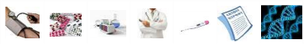
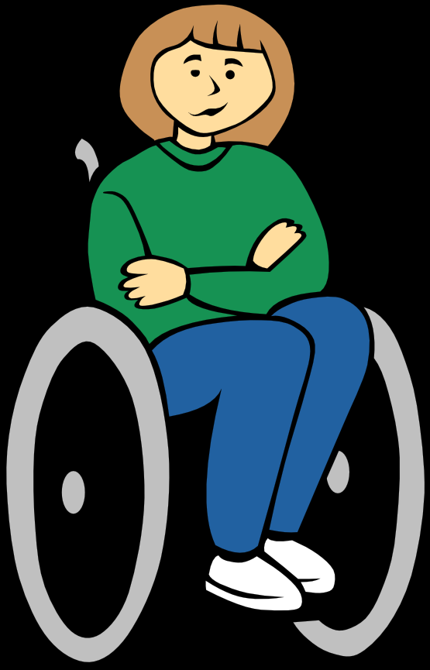
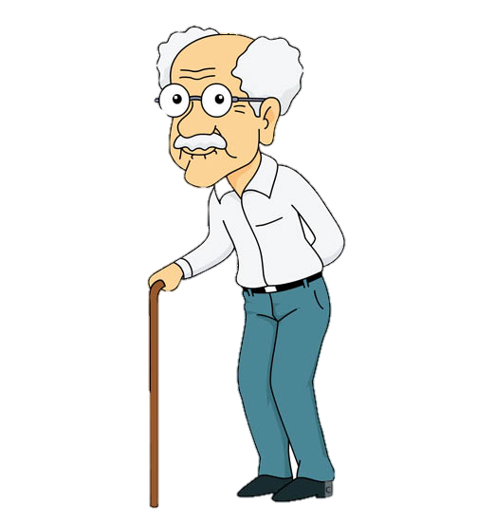

Personalized Decision-Making
Treatment efficacy depends on patient characteristics
Need to personalize decisions
$$⋮$$
pre-existing conditions, concomitant medications, genetic data, etc.

Slide 4
BATTLE Trial (Phase II)
Erlotinib
Vandetanib
Erlotinib plus bexarotene
Sorafenib
Effective on patients with EFGR mutations
Effective on patients with KRAS mutations
Effective on patients with increased expression of VEGFR2
Effective on patients who are positive for cyclin D1 or have EFGR copy number amplifications
Kim et al., BATTLE Trial: Personalizing Therapy for Lung Cancer (2014).
Notes:
Phase II trial, biomarkers selected from Phase I and domain knowledge
Personalized + only a FEW biomarkers matter → make box

Slide 5

e-commerce
Internet user covariates: demographics, past clicks, search keywords
Leverage user information to tailor:
website layout (A/B testing)
featured products (retail)
ads (marketing)

Slide 6
Personalized Decision-Making
Challenges: high-dimensional user covariates, costly experimentation
“Online Decision-Making with High-Dimensional Covariates” (joint work with M. Bayati)
“Mostly Exploration-Free Algorithms for Contextual Bandits” (joint work with M. Bayati and K. Khosravi)

Slide 7
Personalization Pipeline
Historical Data
Prediction
Decision

Slide 8
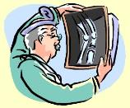







Large Number of Variables
Medications
Radiology
Procedures
Genomics
Diagnoses
Nurse Notes
Lab Tests
Biomarkers
# covariates in medical DM: 1,500 (Bertsimas et al, 2008) 10,000 (Wiens et al, 2012), 40,000 (Razavian et al, 2015), etc.

Slide 9
Online Pipeline
Historical Data
High-dimensional covariates → require lots of historical data
Too costly to randomize initial users
Gather data while making decisions
Prediction
Decision
Feedback

Slide 10
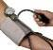

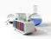

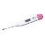
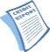

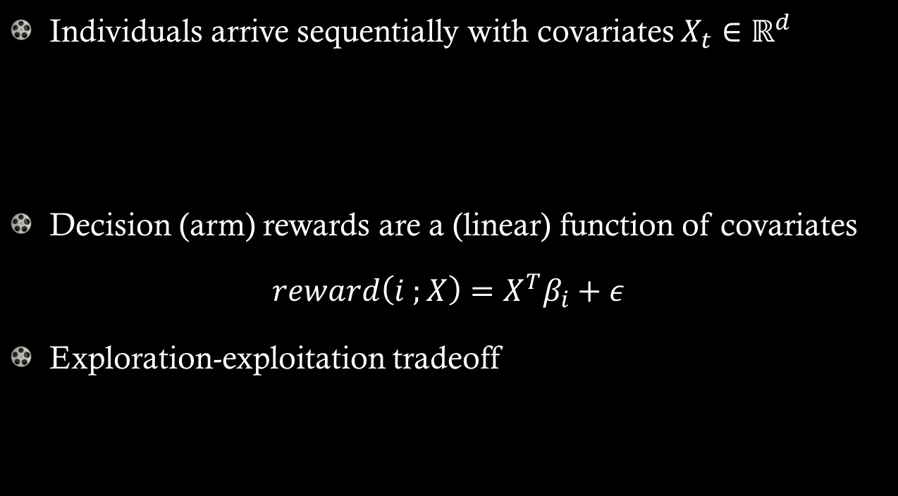
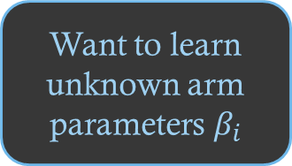
Bandits with Covariates
Individuals arrive sequentially with covariates $X_{t}∈ℝ^{d}$
Decision (arm) rewards are a (linear) function of covariates
$$reward\left(i ;X\right)=X^{T}β_{i}+ε$$
Exploration-exploitation tradeoff
Want to learn unknown arm parameters $β_{i}$
Notes:
What is regret?

Slide 11
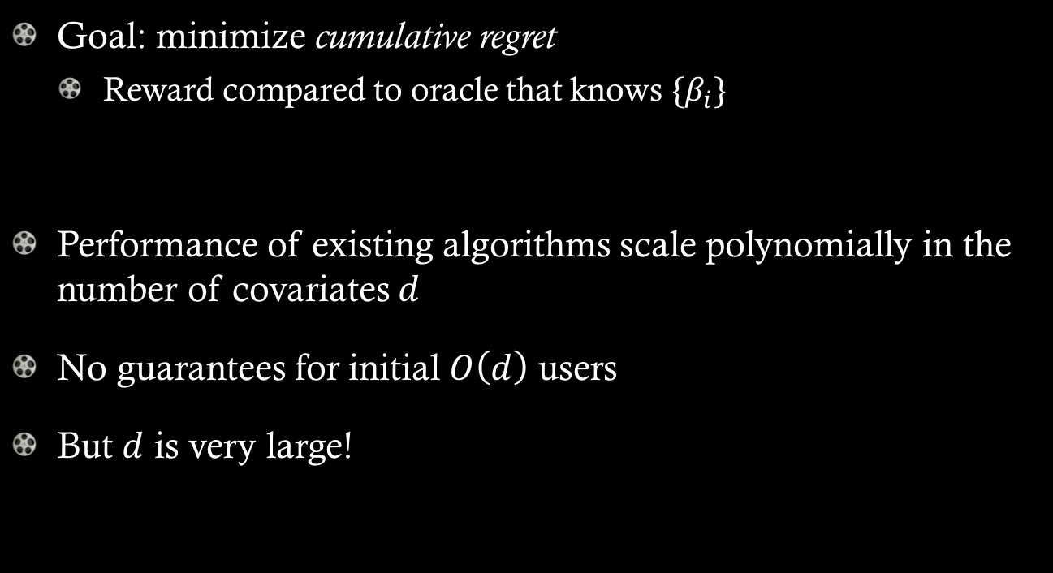
Bandits with Covariates
Goal: minimize cumulative regret
Reward compared to oracle that knows $\{β_{i}\}$
Performance of existing algorithms scale polynomially in the number of covariates $d$
No guarantees for initial $O\left(d\right)$ users
But $d$ is very large!

Slide 12
BATTLE Trial (Phase II)
Only 1-2 biomarkers are relevant to
predicting any given treatment’s success.
Erlotinib
Vandetanib
Erlotinib plus bexarotene
Sorafenib
Effective on patients with EFGR mutations
Effective on patients with KRAS mutations
Effective on patients with increased expression of VEGFR2
Effective on patients who are positive for cyclin D1 or have EFGR copy number amplifications
Kim et al., BATTLE Trial: Personalizing Therapy for Lung Cancer (2014).
Notes:
Phase II trial, biomarkers selected from Phase I and domain knowledge
Personalized + only a FEW biomarkers matter → make box

Slide 13
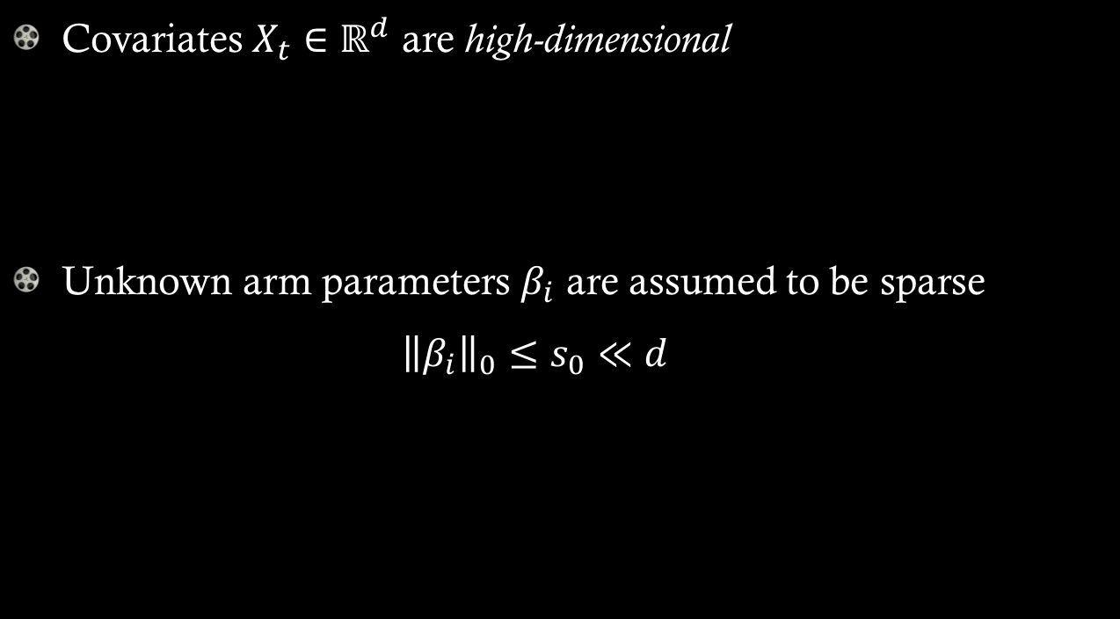
High-Dimensional Covariates
Covariates $X_{t}∈ℝ^{d}$ are high-dimensional
Unknown arm parameters $β_{i}$ are assumed to be sparse ${\left\|β_{i}\right\|}_{0}≤s_{0}≪d$

Slide 14
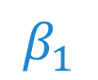
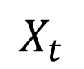
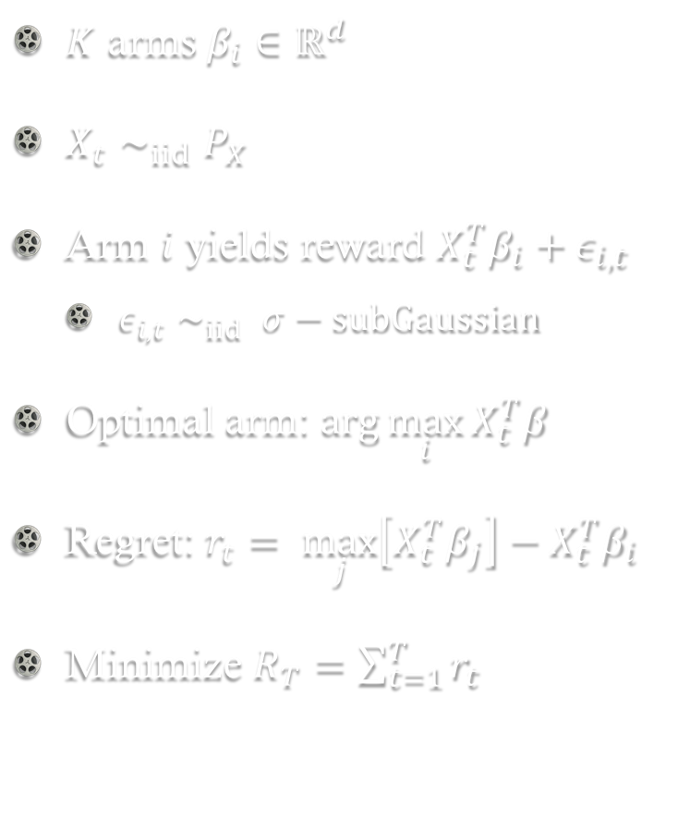
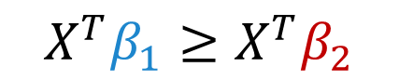

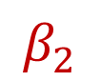
Formulation
$$X^{T}β_{1}≥X^{T}β_{2}$$
$K$ arms $β_{i}∈ℝ^{d}$
$X_{t}∼_{iid}P_{X}$
Arm $i$ yields reward $X_{t}^{T}β_{i}+ε_{i,t}$
$ε_{i,t}∼_{iid} σ−subGaussian$
Optimal arm: $\arg{\max_{i}{X_{t}^{T}β}}$
Regret: $r_{t}= \max_{j}\left[X_{t}^{T}β_{j}\right]−X_{t}^{T}β_{i}$
Minimize $R_{T}=\sum_{t=1}^{T}{r_{t}}$
$$β_{1}$$
$$X_{t}$$
$$β_{2}$$
$$X^{T}β_{1}≤X^{T}β_{2}$$

Slide 15
Overview
Related literature + state main result
Introduce LASSO Bandit algorithm
High-level technical intuition
Case study: Warfarin dosing
Extensions to address ethical concerns with experimentation

Slide 16
Related Literature
Decision-making with covariates
Ban-Rudin ‘14, Bertsimas-Kallus ‘14, Chen-Owen-Pixton-Simchi-Levi ‘15
Bandits with covariates
Also called contextual bandit or linear bandit with changing action space
Nonparametric payoffs: Rigollet-Zeevi ’10, Perchet-Rigollet ’13, Slivkins ‘14
Linear payoffs: Auer ‘03, Langford-Zhang ‘08, Rusmevichientong-Tsitsiklis ‘10, Abbasi-Yadkori-Pal-Szepesvari ‘11 & ‘12, Deshpande-Montanari ‘12, Goldenshluger-Zeevi ‘13 Agrawal-Goyal ‘13, Russo-Van Roy ‘14
High-dimensional statistics: Candes-Tao ‘07, Bickel-Ritov-Tsyabakov ‘09, Negahban-Yu-Wainwright-Ravikumar ‘09, Buhlmann-Van de Geer ‘11, Belloni-Chernozhukov-Hansen ‘13

Slide 17

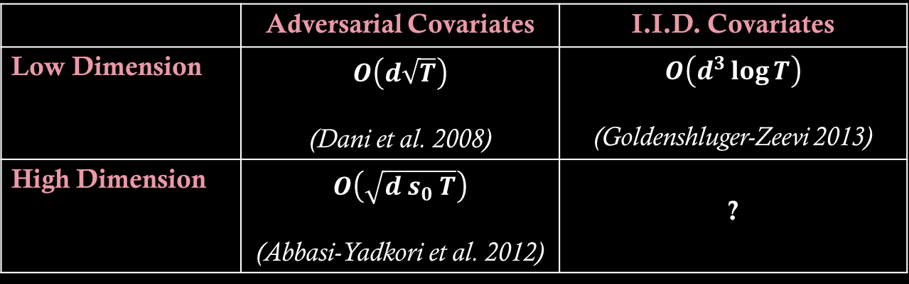
Related Literature
 | Adversarial Covariates | I.I.D. Covariates
Low Dimension | $$O\left(d\sqrt{T}\right)$$ (Dani et al. 2008) | $$O\left(d^{3}\log{T}\right)$$ (Goldenshluger-Zeevi 2013)
High Dimension | $$O\left(\sqrt{d s_{0} T}\right)$$ (Abbasi-Yadkori et al. 2012) | ?
$d$ covariates, $s_{0}$ sparsity, $T$ users

Slide 18
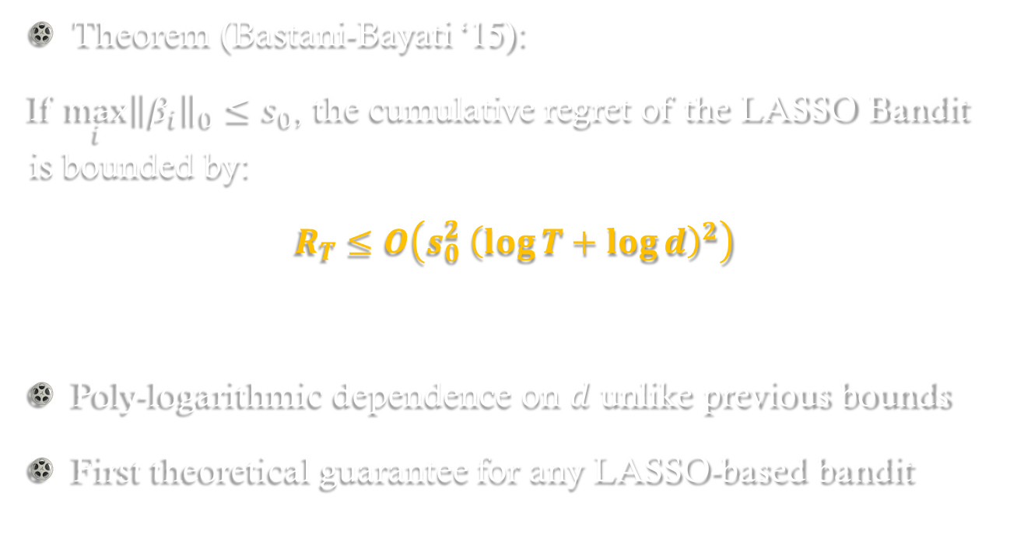
Main Result
Theorem (Bastani-Bayati ‘15):
If ${\max_{i}\left\|β_{i}\right\|}_{0}≤s_{0}$, the cumulative regret of the LASSO Bandit is bounded by:
$$R_{T}≤O\left(s_{0}^{2} {\left(\log{T}+\log{d}\right)}^{2}\right)$$
Poly-logarithmic dependence on $d$ unlike previous bounds
First theoretical guarantee for any LASSO-based bandit

Slide 19
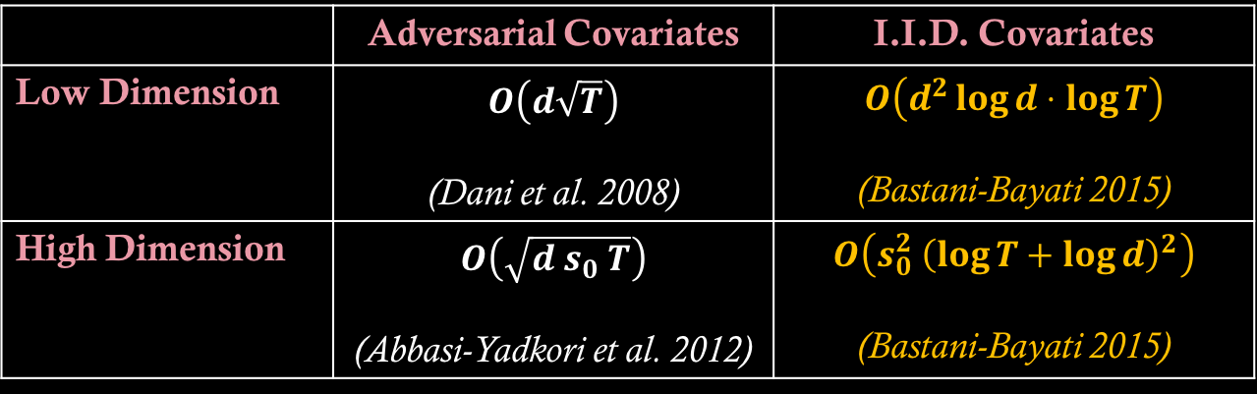
Our Contributions
 | Adversarial Covariates | I.I.D. Covariates
Low Dimension | $$O\left(d\sqrt{T}\right)$$ (Dani et al. 2008) | $$O\left(d^{2}\log{d}⋅\log{T}\right)$$ (Bastani-Bayati 2015)
High Dimension | $$O\left(\sqrt{d s_{0} T}\right)$$ (Abbasi-Yadkori et al. 2012) | $$O\left(s_{0}^{2} {\left(\log{T}+\log{d}\right)}^{2}\right)$$ (Bastani-Bayati 2015)
$d$ covariates, $s_{0}$ sparsity, $T$ users

Slide 20
Algorithm + Technical Intuition

Slide 21
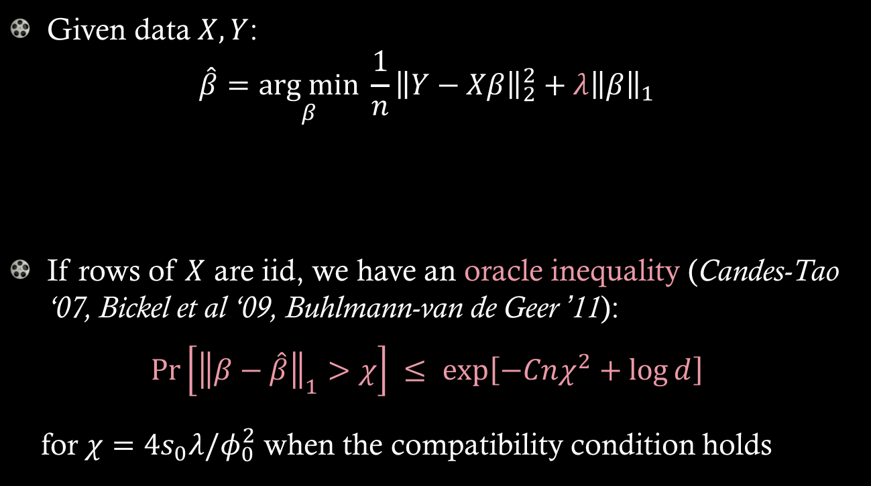
LASSO
Given data $X,Y$: $\hat{β}=\underset{β}{arg min}{ \frac{1}{n}{\left\|Y−Xβ\right\|}_{2}^{2}+λ{\left\|β\right\|}_{1}}$
If rows of $X$ are iid, we have an oracle inequality (Candes-Tao ‘07, Bickel et al ‘09, Buhlmann-van de Geer ’11):
$$\operatorname{Pr}\left[{\left\|β−\hat{β}\right\|}_{1}>χ\right] ≤ \exp\left[−Cnχ^{2}+\log{d}\right]$$
for $χ=4s_{0}λ/φ_{0}^{2}$ when the compatibility condition holds
OLS objective
Shrinkage

Slide 22
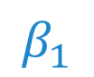
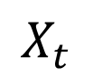
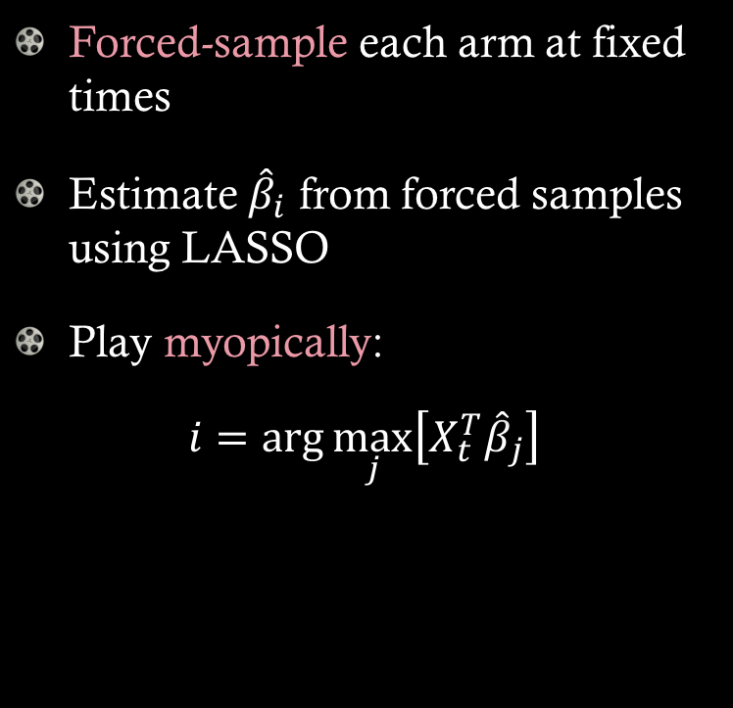
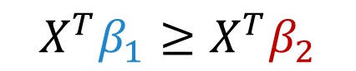


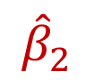
Naïve Algorithm
Forced-sample each arm at fixed times
Estimate ${\hat{β}}_{i}$ from forced samples using LASSO
Play myopically:
$$i=\arg{\max_{j}\left[X_{t}^{T}{\hat{β}}_{j}\right]}$$
$$X^{T}β_{1}≥X^{T}β_{2}$$
$${\hat{β}}_{1}$$
$$β_{1}$$
$$X_{t}$$
$${\hat{β}}_{2}$$
$$β_{2}$$
$ε$-greedy with tuned $ε$
$$X^{T}β_{1}≤X^{T}β_{2}$$

Slide 23

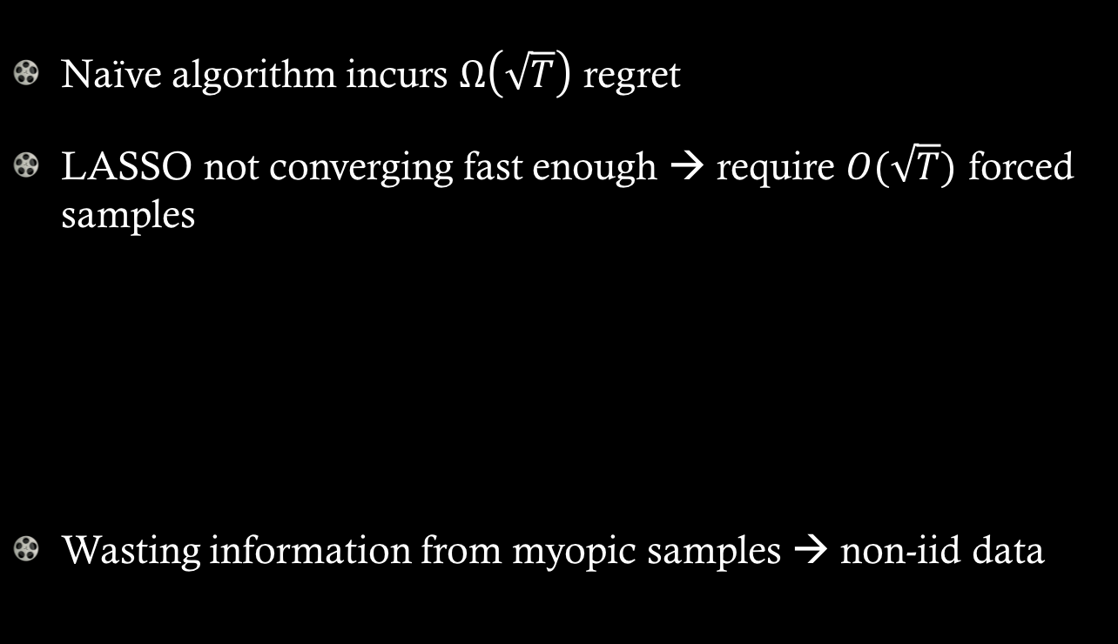

What’s the problem?
Naïve algorithm incurs $Ω\left(\sqrt{T}\right)$ regret
LASSO not converging fast enough → require $O(\sqrt{T})$ forced samples
Wasting information from myopic samples → non-iid data
Forced Samples
Myopic Samples
$$O\left(\sqrt{T}\right)$$
$$O\left(T\right)$$

Slide 24
LASSO Bandit

Slide 25


Algorithm
Maintain two estimators for each arm
Forced-sample estimator (FSE) using only forced samples
All-sample estimator (ASE) using all samples
FSE: few iid samples
ASE: many non-iid samples
Forced Samples
Myopic Samples
$$O\left(\log{T}\right)$$
$$O\left(T\right)$$

Slide 26

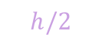

Algorithm
Use FSE to choose a subset of arms that are “indistinguishable” from the estimated optimal arm by a fixed margin
Use ASE to choose among these arms
$$h/2$$
Estimated reward
FSE:
3
1
2
$$X_{t}^{T}{\hat{β}}_{i}^{FSE}$$
ASE:
2
1
3
$$X_{t}^{T}{\hat{β}}_{i}^{ASE}$$
Choose arm 1
Main idea: pre-processing with FSE guarantees convergence of ASE

Slide 27
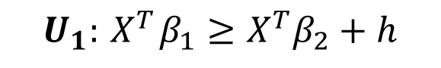

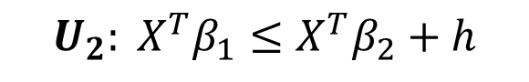
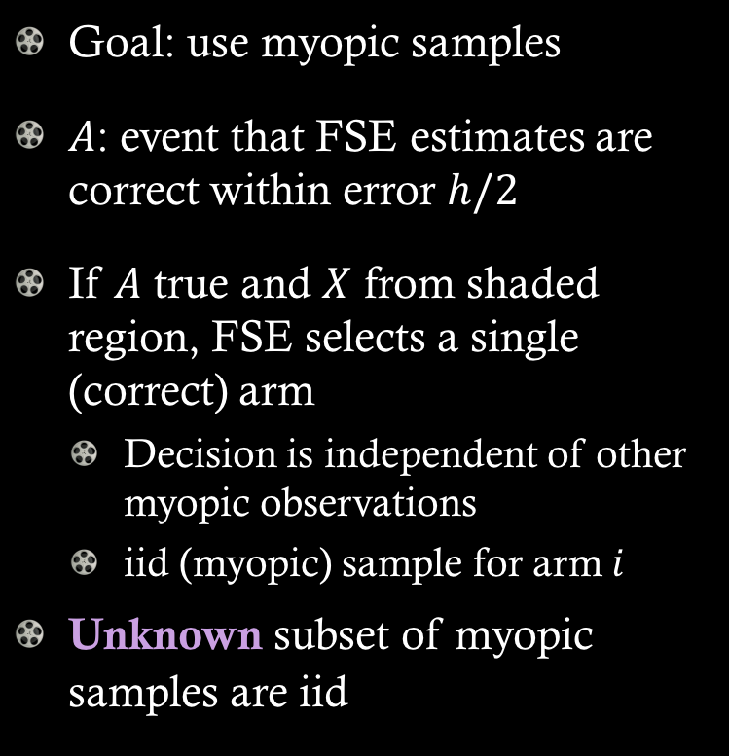
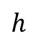
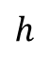
ASE Convergence
$$U_{1}:{ X}^{T}β_{1}≥X^{T}β_{2}+h$$
Goal: use myopic samples
$A$: event that FSE estimates are correct within error $h/2$
If $A$ true and $X$ from shaded region, FSE selects a single (correct) arm
Decision is independent of other myopic observations
iid (myopic) sample for arm $i$
Unknown subset of myopic samples are iid
$$β_{1}$$
$$h$$
$$h$$
$$β_{2}$$
$$U_{2}: X^{T}β_{1}≤X^{T}β_{2}+h$$

Slide 28
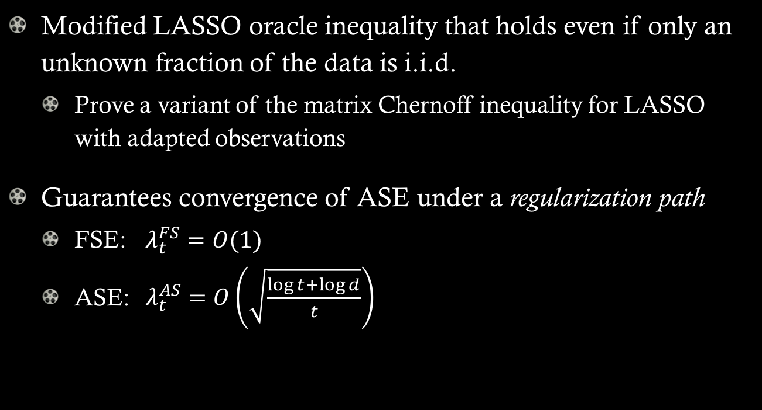
LASSO Convergence
Modified LASSO oracle inequality that holds even if only an unknown fraction of the data is i.i.d.
Prove a variant of the matrix Chernoff inequality for LASSO with adapted observations
Guarantees convergence of ASE under a regularization path
FSE: $λ_{t}^{FS}=O(1)$
ASE: $λ_{t}^{AS}=O\left(\sqrt{\frac{\log{t}+\log{d}}{t}}\right)$
Main result: sum up expected regret from using FSE and ASE

Slide 29
Experiments

Slide 30
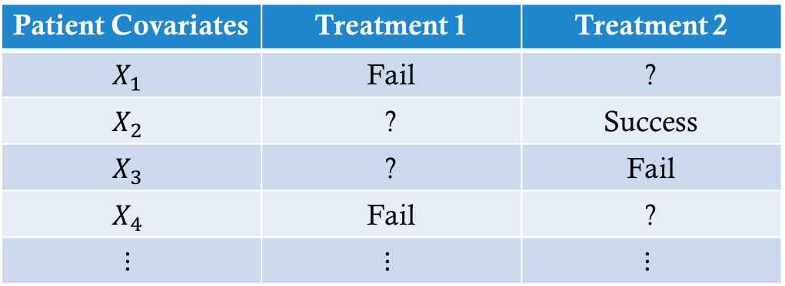
Bandit Feedback
Observational data:
Patient covariates
Outcome of assigned treatment
How to evaluate bandit policy without counterfactuals?
Patient Covariates | Treatment 1 | Treatment 2
$$X_{1}$$ | Fail | ?
$$X_{2}$$ | ? | Success
$$X_{3}$$ | ? | Fail
$$X_{4}$$ | Fail | ?
$$⋮$$ | $$⋮$$ | $$⋮$$

Slide 31

Warfarin Dosing
Blood thinner (30 million prescriptions/yr in US)
Initial dose can be one of three groups:
start too low → stroke; start too high → internal bleeding
Accounts for nearly 43,000 ED visits in the US
Low Dose (3mg)
Normal Dose (5mg)
? ? ?
High Dose (7mg)

Slide 32
Warfarin Dosing
5528 patients with 98 variables
Demographic info: gender, race, ethnicity, age, height, weight
Reason for warfarin treatment: DVT, PE, Afib/flutter, heart valve, cardiomyopathy LV dilation, stroke, post-orthopedic, other
Indicator variables for patient conditions: diabetes, congestive heart failure, cardiomyopathy, valve replacement, smoker
Concomitant medications: aspirin, Tylenol, Zocor, Lipitor, Lescol, Mevacor, Pravachol, Crestor, Baycol, Codarone, Tegretol, Dilantin, Rifampin/Rifampicin, Sulfonamide antibiotics, Macrolide antibiotics, Anti-fungal azoles, herbal medications, vitamins or supplements
Genetic factors: presence of genotype variants of CYP2C9 and VKORC1

Slide 33
Warfarin Dosing
Data suggests best fit model is OLS (no sparsity)
3 arms: low, normal, or high dose
Evaluation: observe optimal dose
Provides counterfactuals
Unobserved by bandit algorithms
Binary reward: was chosen arm correct?

Slide 34
Warfarin Dosing
Compare to
Approximate Oracle: estimate true arm parameters from all data
Physician: always normal dose
OFUL-EG (Abbasi-Yadkori et al., 2012)
OFUL-LS (Dani et al., 2008; Abbasi-Yadkori et al., 2011)
OLS Bandit (Goldenshluger and Zeevi, 2013)

Slide 35
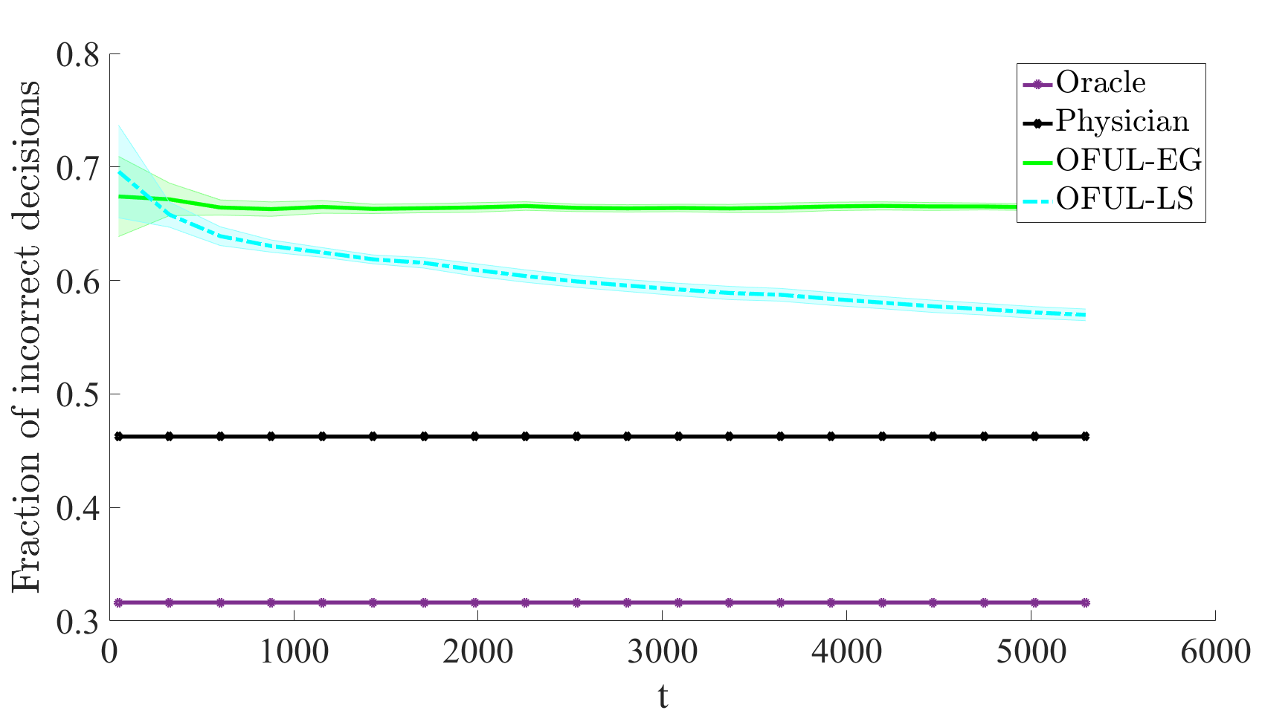
Results on Warfarin Data
d=100, T=5500
OFUL does not beat static physician policy even after 5500 patients

Slide 36
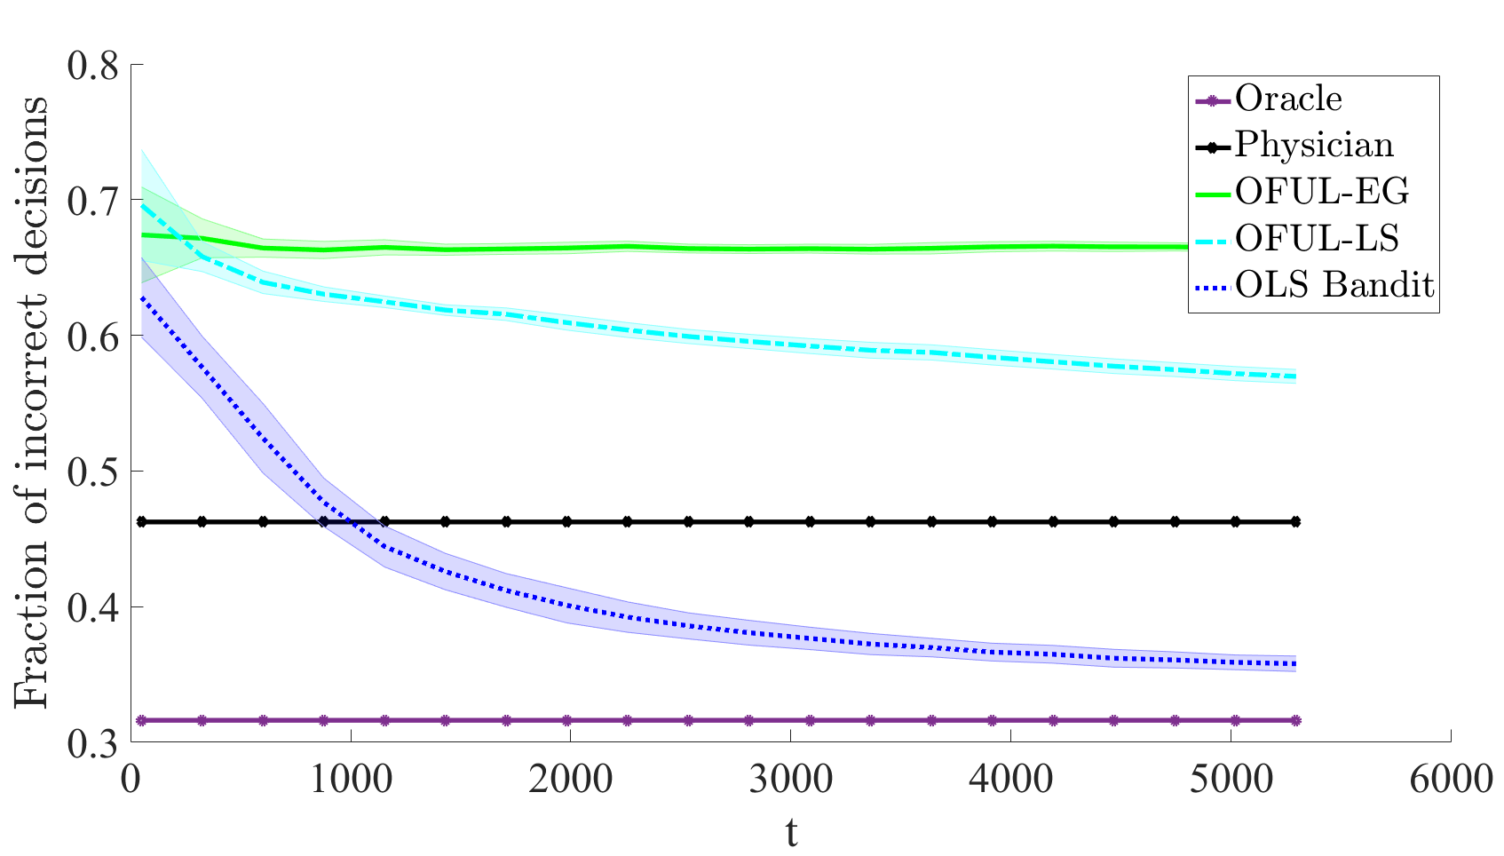
Results on Warfarin Data
d=100, T=5500
OFUL does not beat static physician policy even after 5500 patients
OLS Bandit beats static physician policy after 1100 patients

Slide 37
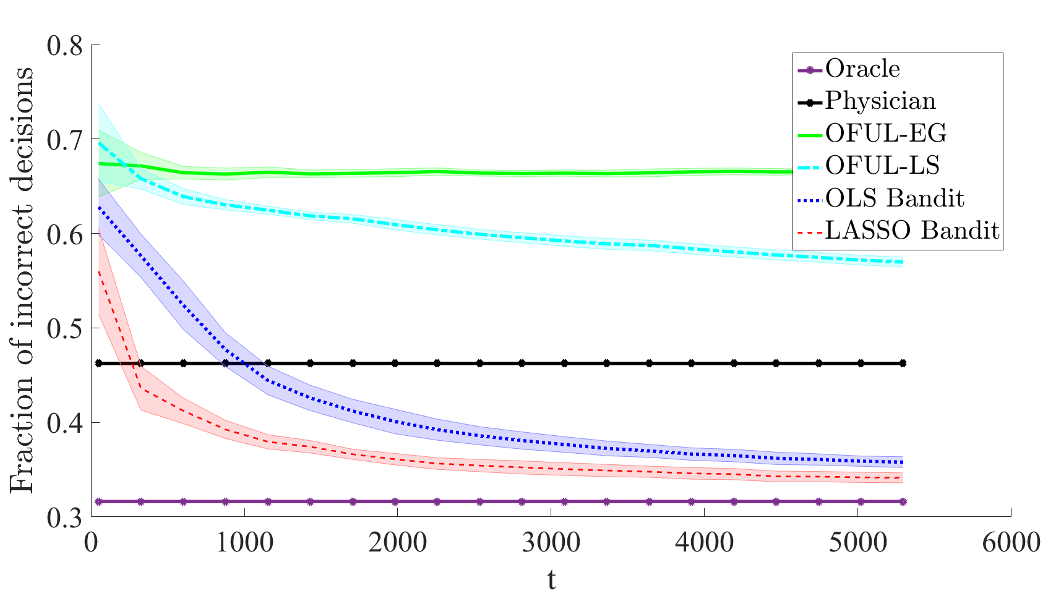
Results on Warfarin Data
d=100, T=5500
OFUL does not beat static physician policy even after 5500 patients
OLS Bandit beats static physician policy after 1100 patients
LASSO Bandit beats static physician policy after 200 patients

Slide 38
Risk Implications
LASSO Bandit policy:
Given \ True | Low | Medium | High
Low | 57% | 14% | 3%
Medium | 42% | 83% | 90%
High | 1% | 3% | 7%
% of Patients | 33% | 54% | 13%
Very small chance (0.7%) of increased risk
Reward function can be adjusted
Huge improvement in correctly dosing low-dosage patients

Slide 39



Experimentation
Practitioners dislike experimentation
Unethical in healthcare
Prohibitively costly in online platforms
Forced Samples
Myopic Samples
$$O\left(\sqrt{T}\right)$$
$$O\left(T\right)$$
$ε$-greedy
OLS / LASSO Bandit
$$O\left(\log{T}\right)$$
$$O\left(T\right)$$
$$O\left(T\right)$$
Pure Greedy

Slide 40
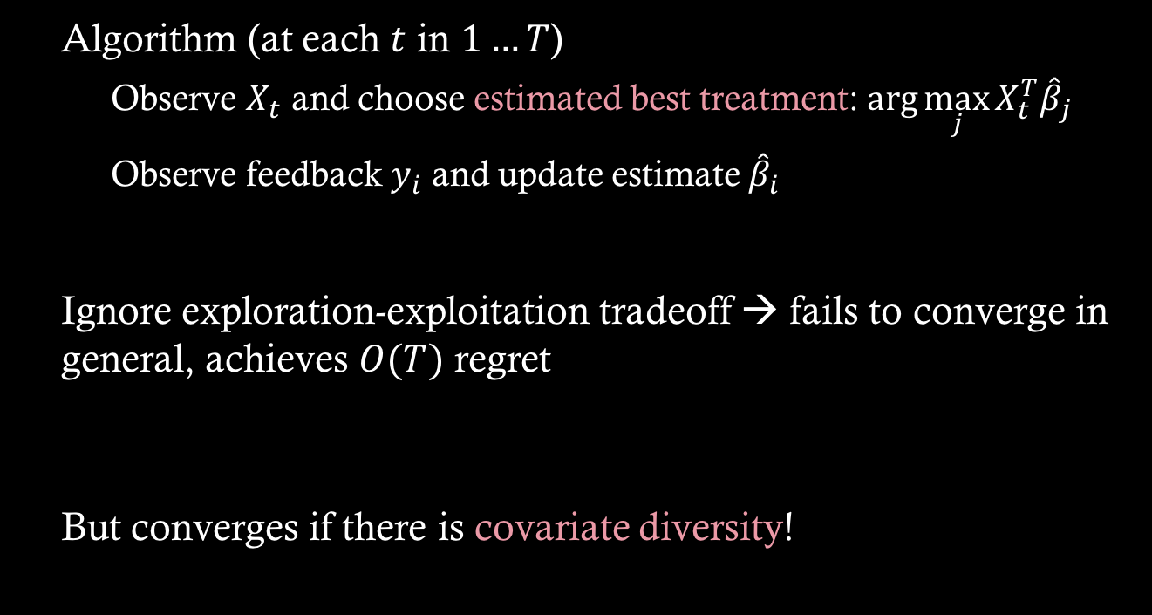
Greedy Bandit
Algorithm (at each $t$ in $1…T$)
Observe $X_{t}$ and choose estimated best treatment: $\arg{\max_{j}{X_{t}^{T}{\hat{β}}_{j}}}$
Observe feedback $y_{i}$ and update estimate ${\hat{β}}_{i}$
Ignore exploration-exploitation tradeoff → fails to converge in general, achieves $O(T)$ regret
But converges if there is covariate diversity!

Slide 41
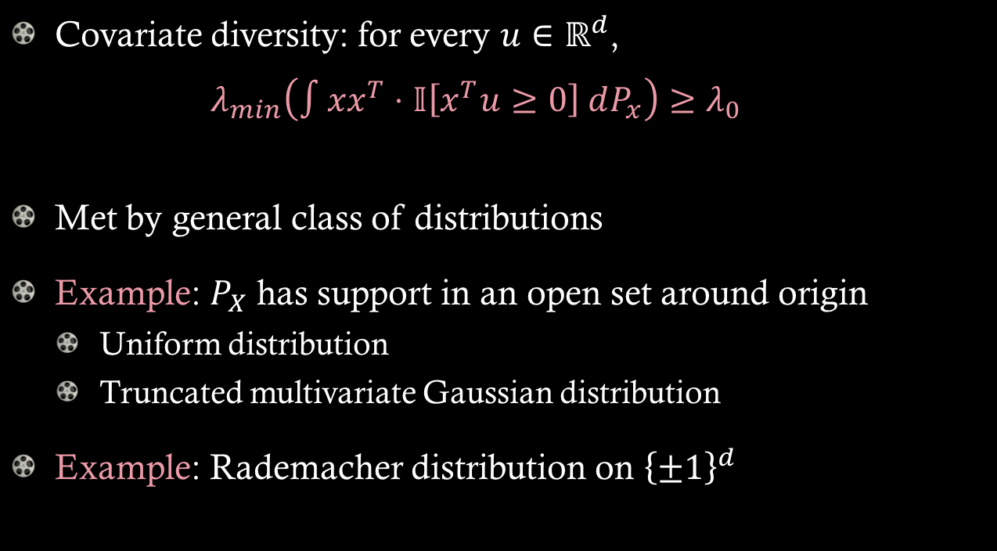
Covariate Diversity
Covariate diversity: for every $u∈ℝ^{d}$, $λ_{min}\left(∫xx^{T}⋅𝕀\left[x^{T}u≥0\right] dP_{x}\right)≥λ_{0}$
Met by general class of distributions
Example: $P_{X}$ has support in an open set around origin
Uniform distribution
Truncated multivariate Gaussian distribution
Example: Rademacher distribution on ${\left\{±1\right\}}^{d}$

Slide 42
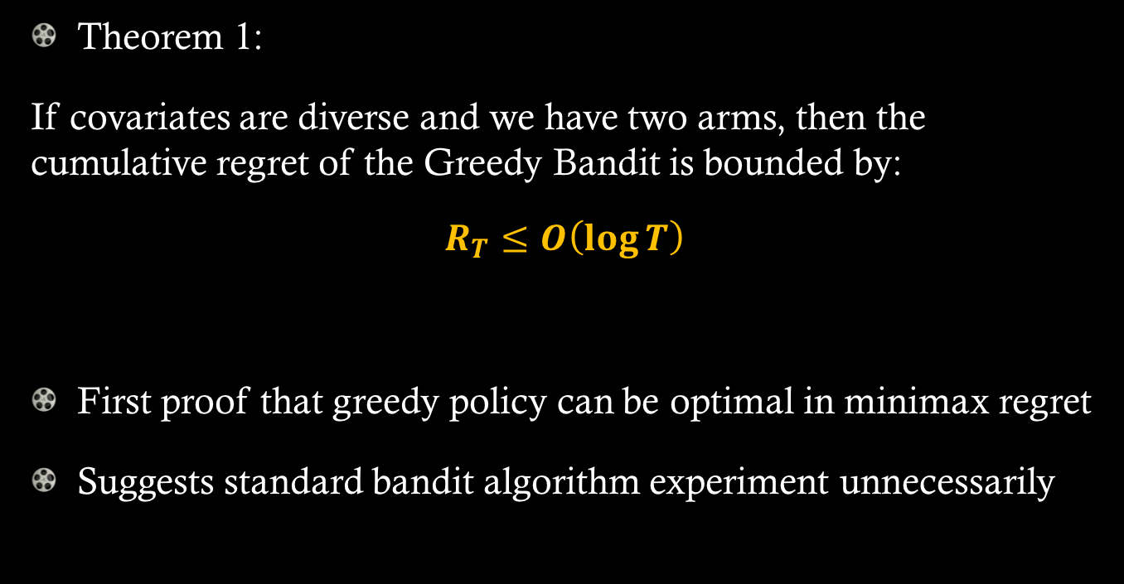
Convergence: Greedy
Theorem 1:
If covariates are diverse and we have two arms, then the cumulative regret of the Greedy Bandit is bounded by:
$$R_{T}≤O\left(\log{T}\right)$$
First proof that greedy policy can be optimal in minimax regret
Suggests standard bandit algorithm experiment unnecessarily

Slide 43
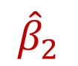
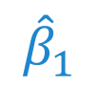

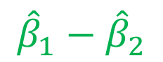
Intuition
$$P_{X}$$
Play arm 2
$${\hat{β}}_{1}$$
$${\hat{β}}_{1}−{\hat{β}}_{2}$$
$${\hat{β}}_{2}$$
Play arm 1
Diverse covariates
each arm played infinitely often regardless of current estimates
estimates converge quickly

Slide 44
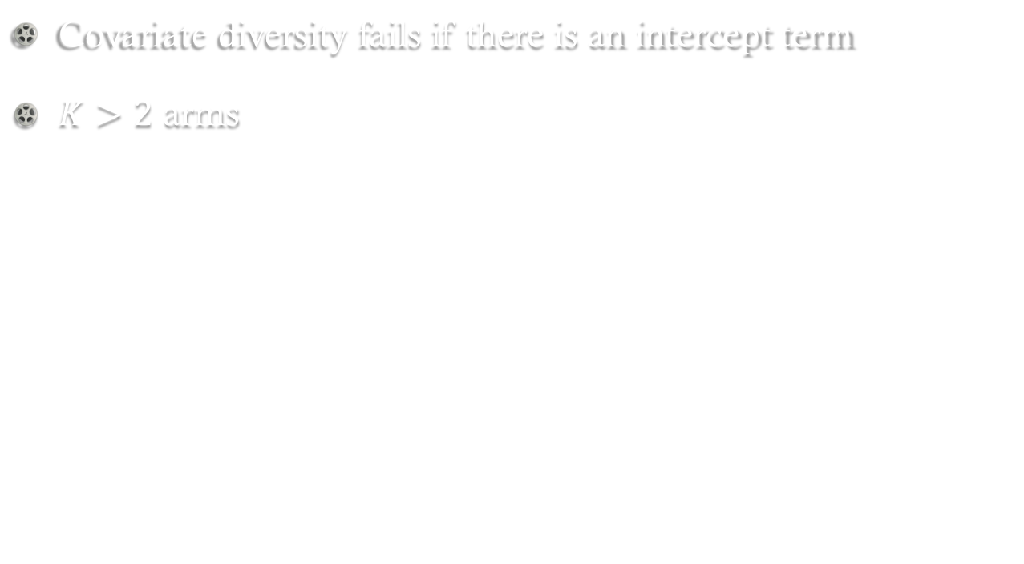
What if assumptions fail?
Covariate diversity fails if there is an intercept term
$K>2$ arms

Slide 45
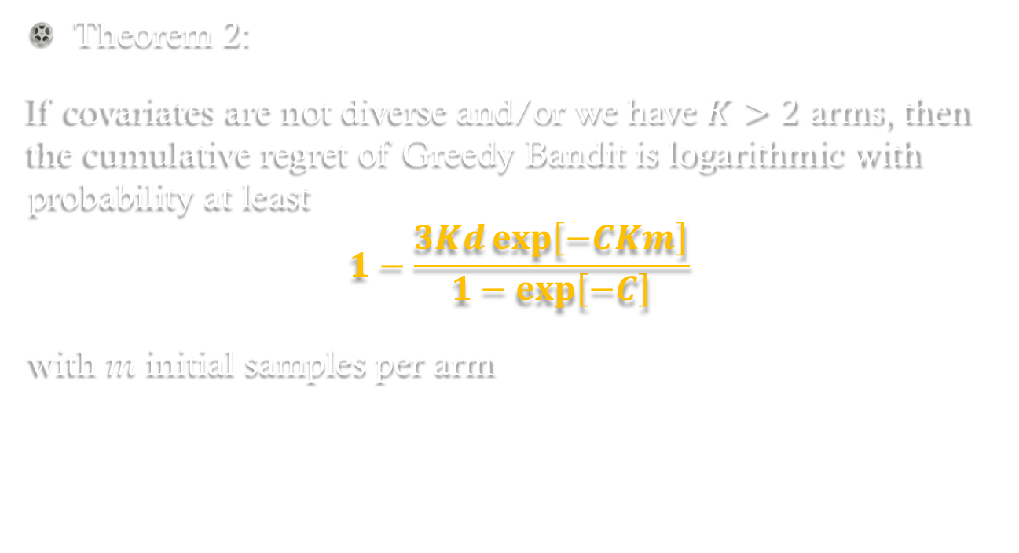
Probabilistic Guarantee
Theorem 2:
If covariates are not diverse and/or we have $K>2$ arms, then the cumulative regret of Greedy Bandit is logarithmic with probability at least
$$1−\frac{3Kd\exp\left[−CKm\right]}{1−\exp\left[−C\right]}$$
with $m$ initial samples per arm

Slide 46
Greedy Bandit
Greedy Bandit outperforms other bandit algorithms when covariates are diverse
Explains why literature suggests taking smaller confidence sets
But… greedy bandit fails badly without covariate diversity
Works with some probability
How can we ensure asymptotic convergence while avoiding unnecessary experimentation?
Idea: use observed data to check for covariate diversity

Slide 47
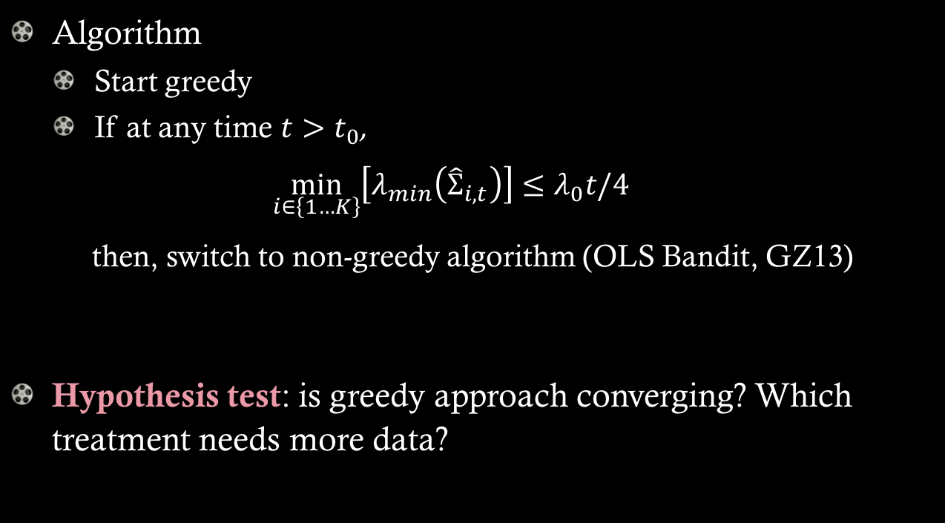
Greedy-First
Algorithm
Start greedy
If at any time $t>t_{0}$,
$$\min_{i∈\left\{1…K\right\}}\left[λ_{min}\left({\hat{Σ}}_{i,t}\right)\right]≤λ_{0}t/4$$
then, switch to non-greedy algorithm (OLS Bandit, GZ13)
Hypothesis test: is greedy approach converging? Which treatment needs more data?

Slide 48
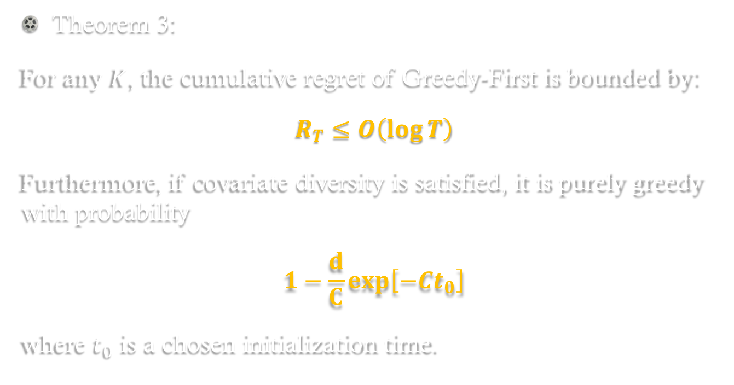
Convergence: Greedy-First
Theorem 3:
For any $K$, the cumulative regret of Greedy-First is bounded by:
$$R_{T}≤O\left(\log{T}\right)$$
Furthermore, if covariate diversity is satisfied, it is purely greedy with probability
$$1−\frac{d}{C}exp\left[−Ct_{0}\right]$$
where $t_{0}$ is a chosen initialization time.

Slide 49
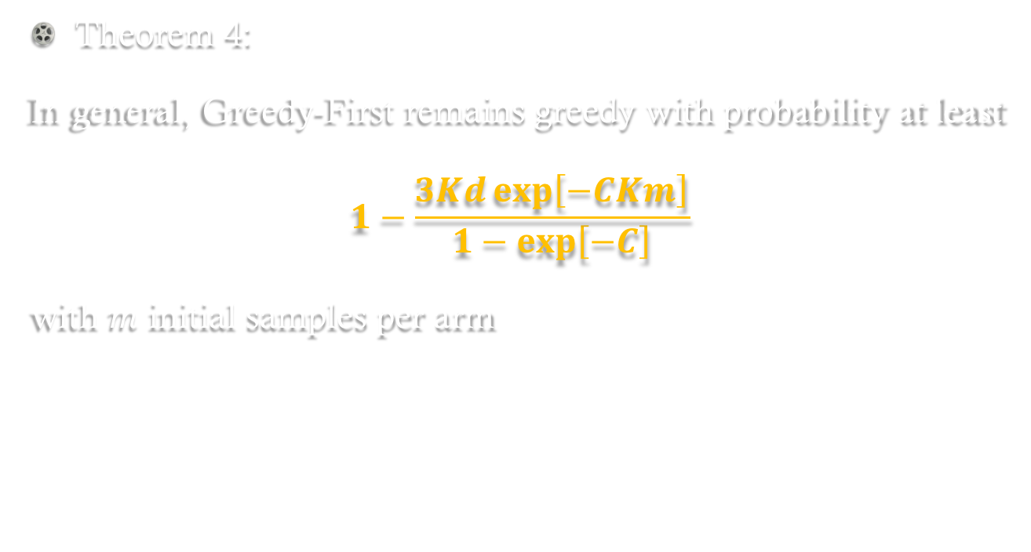
Probabilistic Guarantee
Theorem 4:
In general, Greedy-First remains greedy with probability at least
$$1−\frac{3Kd\exp\left[−CKm\right]}{1−\exp\left[−C\right]}$$
with $m$ initial samples per arm

Slide 50
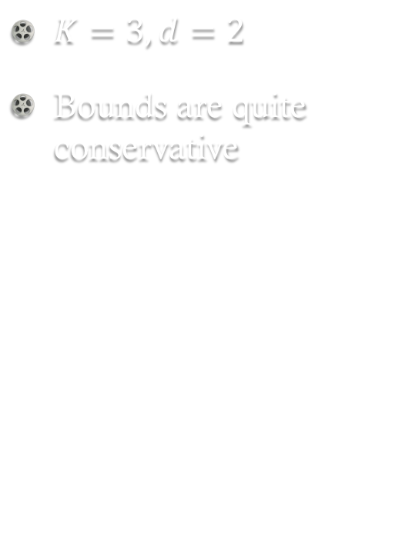
Probabilistic Guarantee
$K=3, d=2$
Bounds are quite conservative

Slide 51

Simulations (Synthetic)
Compare
OFUL-LS (Dani et al., 2008; Abbasi-Yadkori et al., 2011)
OLS Bandit (Goldenshluger and Zeevi, 2013)
Thompson Sampling
Prior-free (Agrawal-Goyal, 2013)
Prior-dependent (Russo-Van Roy, 2014)
Greedy Bandit: always myopic
Greedy-First: starts myopic, switches to OLS Bandit
Repeat each algorithm 1000 times under Bayesian setting, i.e., arm parameters $β_{i}$ sampled each time

Slide 52
Covariate Diversity
OFUL and TS given true prior and parameters
Covariates from mixture of Bernoulli and Gaussians
Greedy, Greedy-First perform best
Expected Regret
Samples

Slide 53
No Covariate Diversity
OFUL and TS given true prior and parameters
No covariate diversity
Greedy is worst
Greedy-First is best
Expected Regret
Greedy works ~90% of the time even when covariates are not diverse
Samples

Slide 54
Simulations (Real Data)
Public datasets
EEG (OpenML)
Eye Movement (OpenML)
Cardiotocography (OpenML)
Warfarin (International Warfarin Pharmacogenetics Consortium)
Not Bayes regret

Slide 55
Real Datasets
EEG
Eye Movement

Slide 56
Real Datasets
Cardiotocography
Warfarin

Slide 57
Summary
Practical challenges in online decision-making
High-dimensional covariates, excessive early experimentation: LASSO Bandit
New regret bounds that are poly-logarithmic in # of covariates
Significantly improves performance for initial users
Practical value in a healthcare case study
Avoid costly experimentation: Greedy-First
Proof of optimality of greedy policy under covariate diversity
Reduces unnecessary user experimentation

Slide 58
Future Directions
Analyze better predictive models
More complex decision-making problems
Example: returning patients, capacity constraints
Cost of information (predictive covariates)
Robust learning if covariates / outcomes data is not accurate

Slide 59
Thank You!
hamsab@wharton.upenn.edu
JMHH 557

